Slide 1
Preventing opioid overdoses in NYC
Ryan Solava

Slide 2
The problem
The opioid epidemic: Major concern across the US --- 42,000 deaths in 2016
Worsening lately
HealingNYC started in 2016
Informational campaign
Our role:
What stations to display life saving posters?

Slide 3
Data Sources
NYC MTA Turnstile Data
Counted number of entries at each station by day
July, August, September 2021
New York state Department of Health Opioid-related data:
Number of deaths due to opioid overdose by borough
2010-2018
MTA Station & Borough locations
Excluding Staten Island

Slide 4
Plan and Tools
Tools:
SQLite & SQLalchemy – Create MTA database and load into Python
Python & Pandas – Clean and analyze data
Matplotlib – Create visualizations
Geopandas -- Work with geodata (location based data) and plot it
Contextily – Find map backgrounds for specific locations

Slide 5
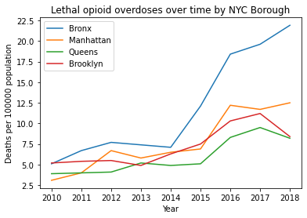
Which borough is most affected?
The Bronx is the area of most concern
Focus on the Bronx for the rest of the talk
Find the top 5 stations in the Bronx

Slide 6
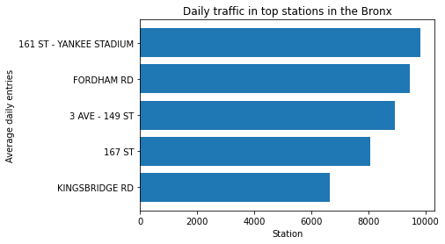
Which borough is most affected?
The Bronx is the area of most concern
Focus on the Bronx for the rest of the talk
Find the top 5 stations in the Bronx

Slide 7
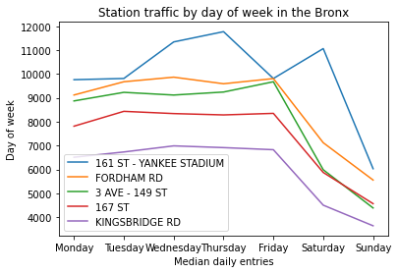
Day of week
Most opioid overdoses happen Monday thru Thursday
Most of the top stations are busiest on those days
Good candidates

Slide 8
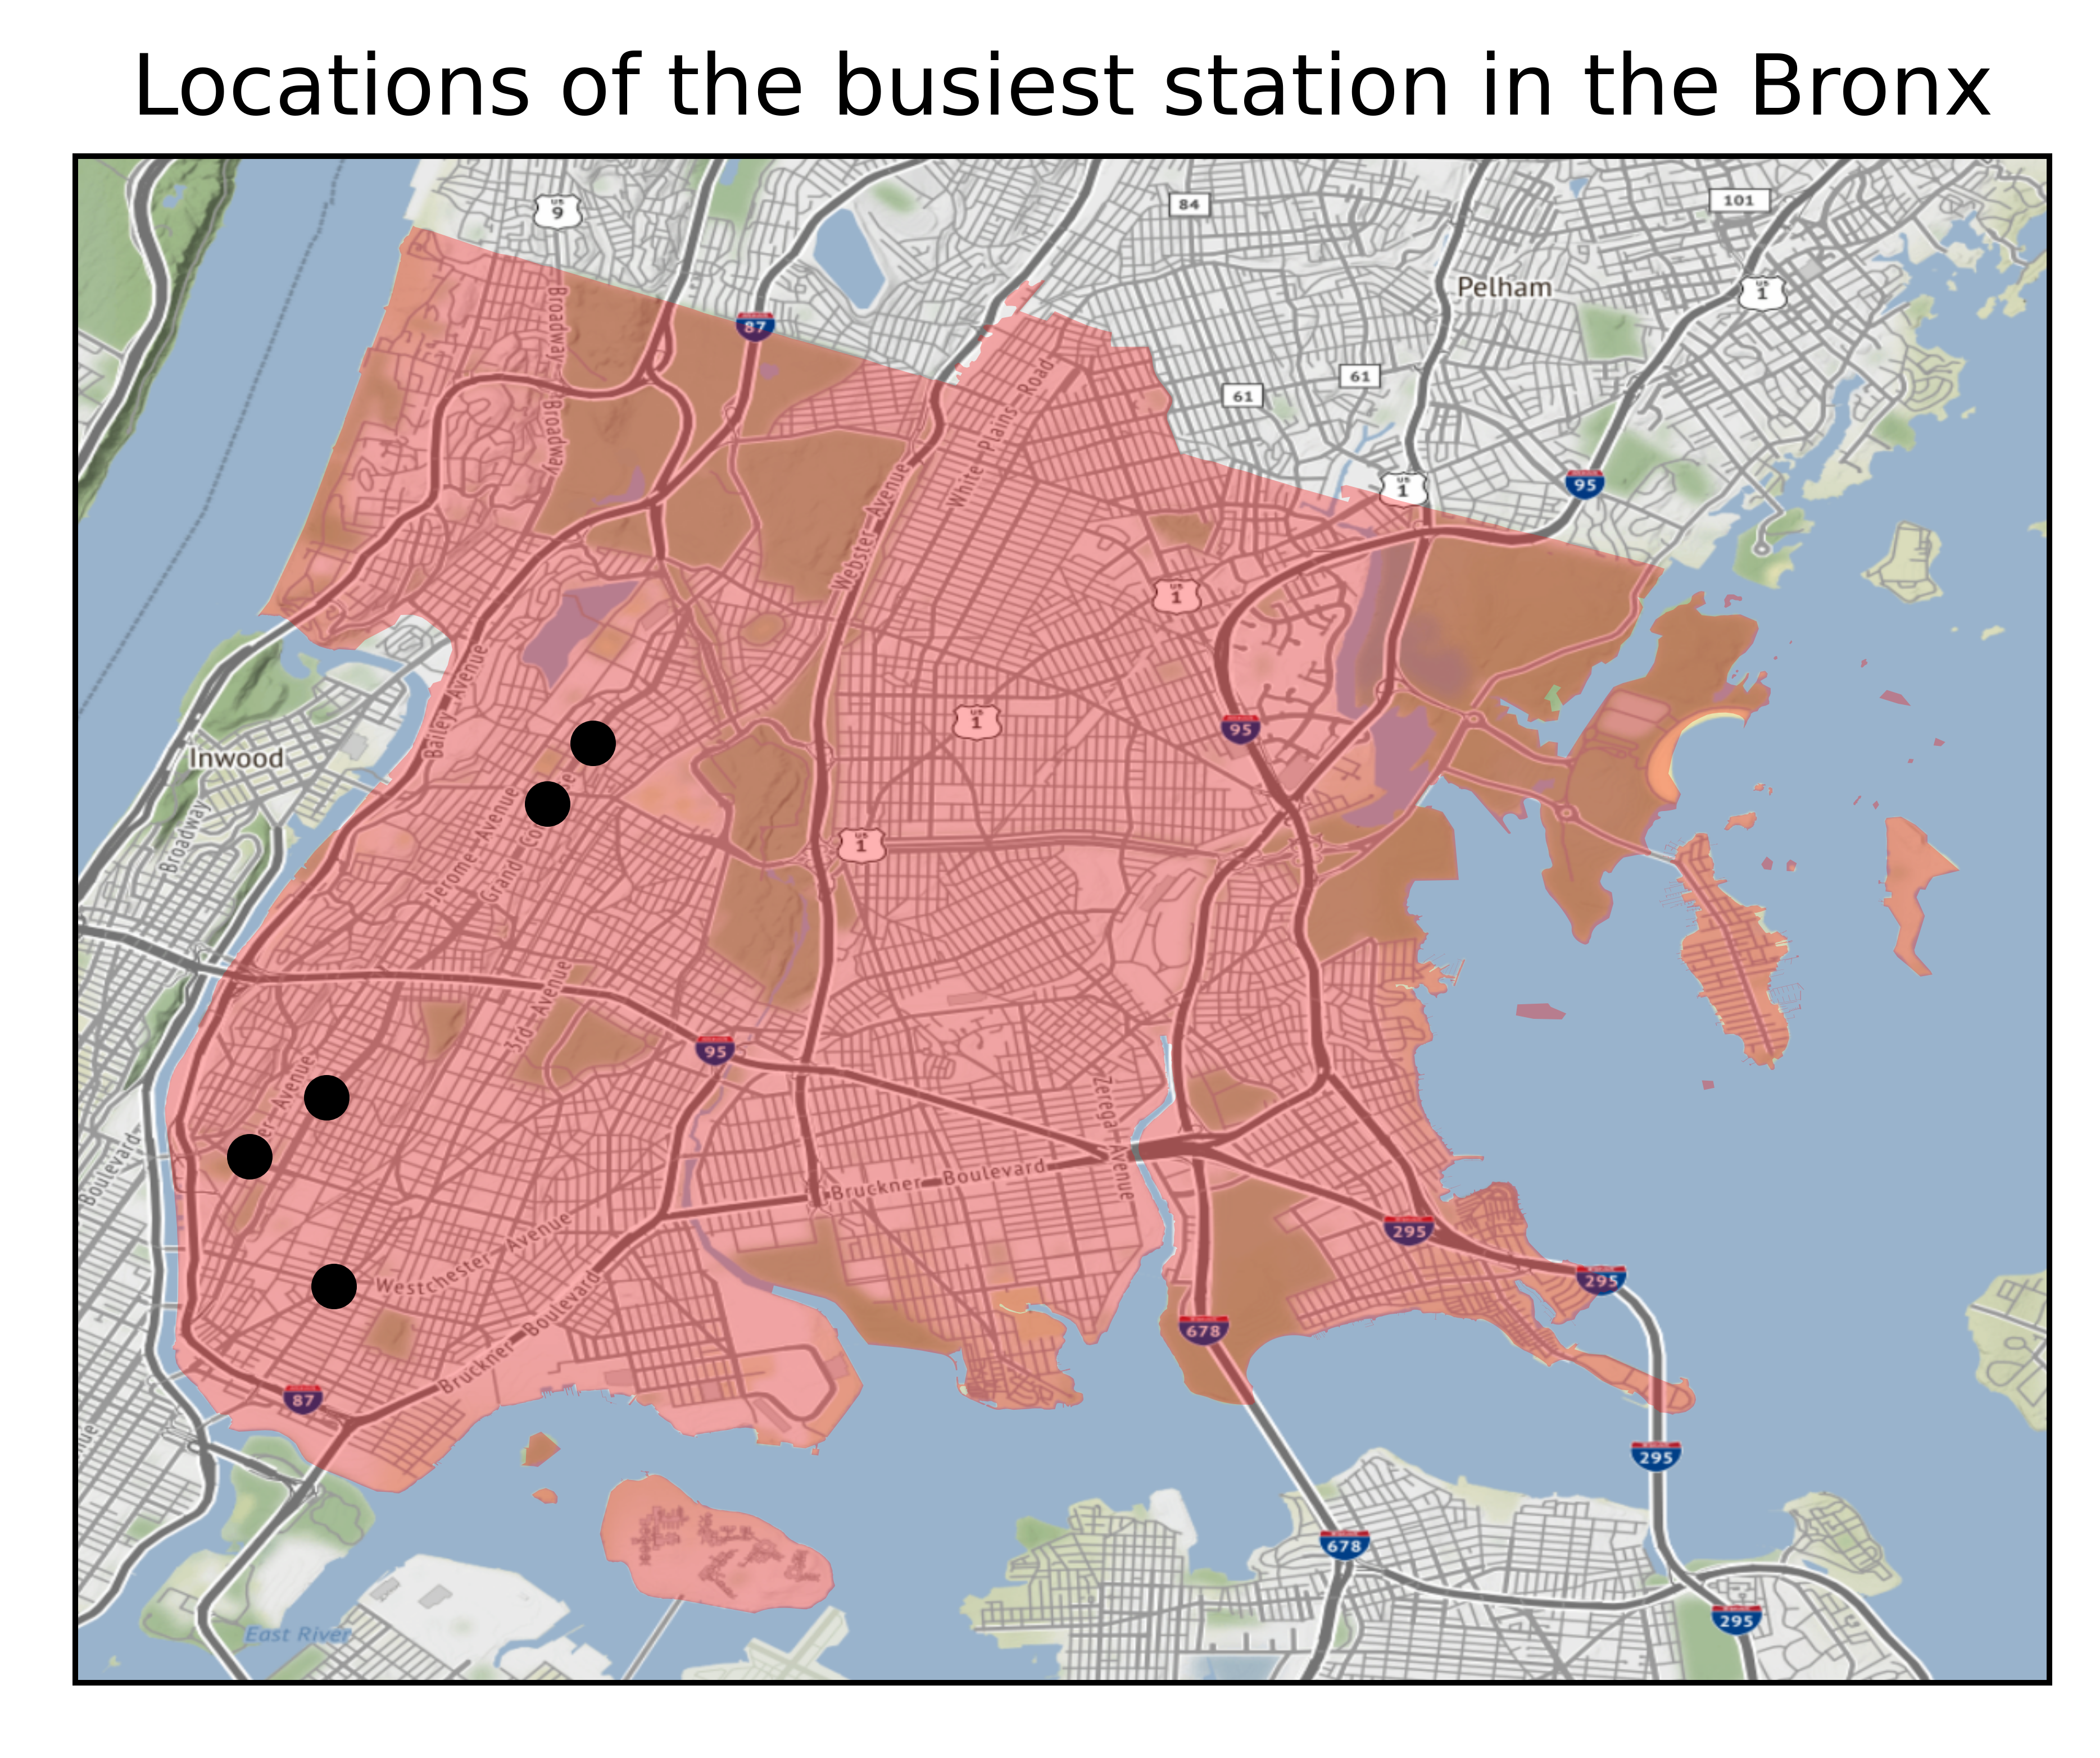
Are the stations distributed well geographically?
No
Mostly in the areas closest to Manhattan
Consider other methods of reaching individuals

Slide 9
Recommendations
Recommend distributing in 4 stations in the Bronx:
Yankee Stadium
Fordham Rd.
3rd Ave. – 149th St.
167th St.
1-3 stations in other boroughs
Consider other modes of communication (especially for the Bronx)

Slide 10
Future work
More recent opioid data (especially 2020 and 2021)
Include Staten Island
Use more specific location and demographic data about affected individuals

Slide 11
Thank you!
Any questions?

Slide 12
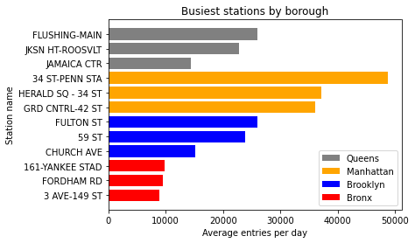
Which stations to target in each borough?
Some candidate stations for each borough

